Slide 1


Welcome to IECS
A warm welcome to Management Infotech System (IECS), your entry into the exciting world of Skills Development. There has been a great revolution in the education field with computers being viewed as the core strength and competitive differentiator in a candidate’s profile. In today's professional environment, employers seek computer literates who are job ready from day one. This is where IECS certificate and diploma programme for students step in. Designed keeping industry requirements in mind and backed by
certification recognised by Government deparments, PSUs and Corporates , these diploma programmes give a professional edge for a good start in the IT world. With a vision to train and mould the best IT professionals, Management Infotech System has established itself in the year 1993 as a computer training institute. It has a strong focus on quality training and has pioneered a unique way to groom students with its smart lab plus training methodology. We at IECS always endeavour to meet the growing needs of Skilled menpower by adopting new technologies, providing resources and by developing positive attitudes. Focusing not only on delivering an effective curriculum, we instil the values of a positive attitude, team spirit and adaption to change. The institute is committed to equity, promoting talent and concerns more about a technocrat/managerial mind set. I strongly feel that you would love to enjoy the proud privilege of becoming a part of this prestigious institute.
PEEYUSH JAIN DIRECTOR GOLD MEDALIST (IIT-ROORKEE)

Slide 2

About us
IECS (Management Infotech System) is the pioneer institute of North region imparting Skills Development training since 1993. It is established with main objective 'To provide quality Computer Education at nominal fee to equip the masses with latest trends in Information Technology'. It has been recognised by AICTE-DOEACC (Ministry of Information Technology, Govt. of India) to conduct its 'O' Level & 'CCC' Courses since 1994 & 1997. It gives the students a "dual qualification" benefit as certificates would be provided to successful candidates by IECS as well as NIELIT (Ministry of Information Technology, Govt. of India).We offer wide spectrum of Skills Development Courses for Career Development and professional skill enhancement for beginners, school and college students, career aspirants and customised training programmes for corporate sector. Besides latest infrastructure, we have got experienced faculty and state of art lab facilities, Course contents and Course material. With a teaching methodology that blends a well designed systematic course structure with intensive practice sessions on computer and the latest software, IECS prepares a student with a right approach to a perfect career. The instructional methodology comprises a regular system of examination, quizzes, internal tests and assignments, practical tests, simulation projects and viva. Our Mission

Slide 3
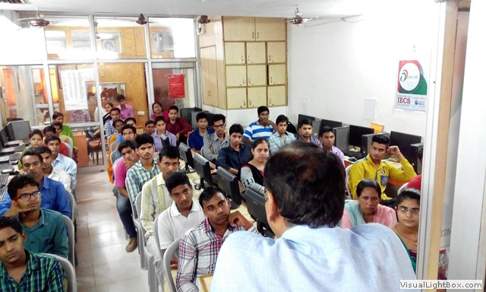
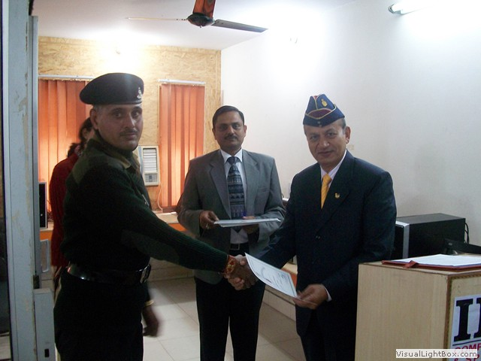
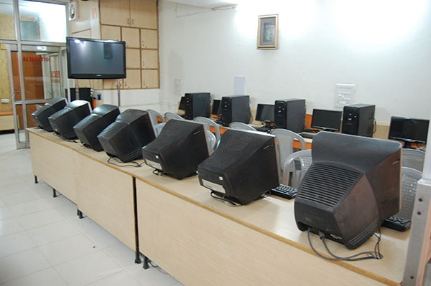
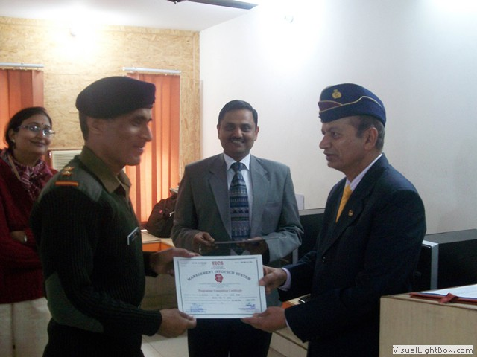
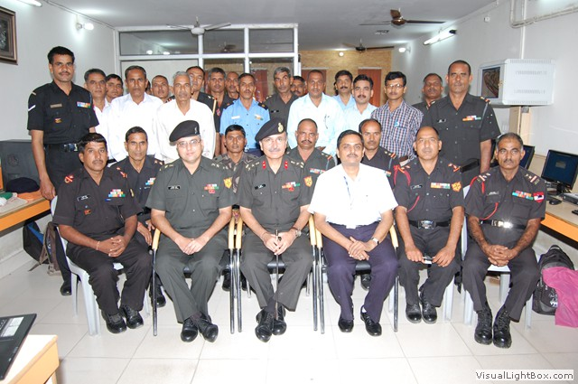
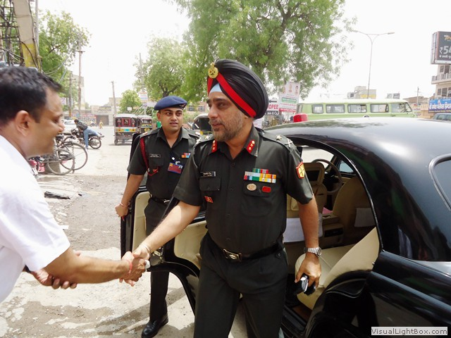
Image gallary

Slide 4

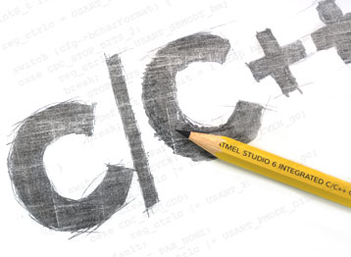

Course offered by us
NIELIT (DOEACC)
DURATION: 2 YEARS
NIELIT (DOEACC)
The Ministry of I.T. (MIT,formerly Department of Electronic) Govt. of India is operating a scheme namely,the Department of Electronics Accreditation of Computer Courses(DOEACC). The scheme is the outcome of working Group set up by the All India Council for Technical Education(AICTE) which is the highest body for the development of technical education including computer education in the country. The AICTE has delegated the responsibility to MIT which has authorised the NIELIT (DOEACC) to implement the scheme. Under this scheme various specified level of courses. We are accredited to conduct its 'O' Level, 'A' Level, 'CCC' & 'BCC' courses.
DURATION: 2 MONTHS
C & C++
C & C ++
C & C++ are basic language from its startup up level to the newest features of ANSI-C++, including basic concepts such as Data Types,Operators,Loop,Arrays Classes,Constructor etc. and advanced concepts such as Polymorphism or Templates,Exception Handling,,File Handling.
DURATION: 6 MONTHS
Visual Studio .Net
Visual Studio.Net
Visual Studio is used to make Windows Based Application,Websites and Mobile Applications.It provoides rich user interface for making enterprise application.

Slide 5
Management Infotech System
(IECS Computer Education)
8, Railway Road, Above Oriental Bank of Commerce Near Old Over Bridge & HDFC Bank, Hisar-125001 (Haryana) India Telephone: +91-1662-231058, Mobile: +91-9812033058, +91-9215533058 Email : iecshsr@gmail.com, icchisar@gmail.com

Slide 6
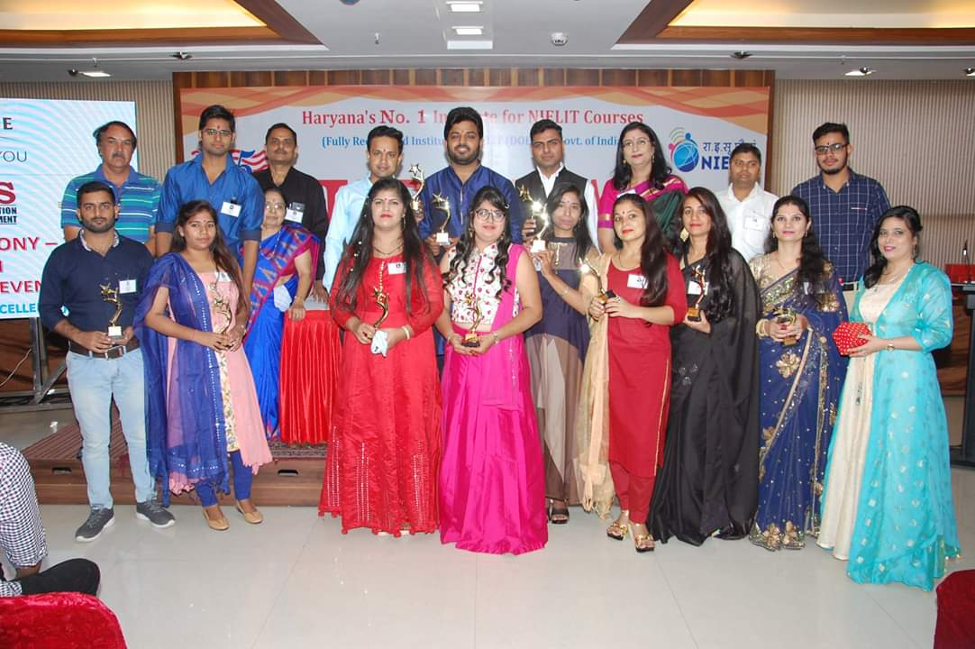
Last but not least our promising & talented teachers and specially our sumeshta mam

